Slide 1
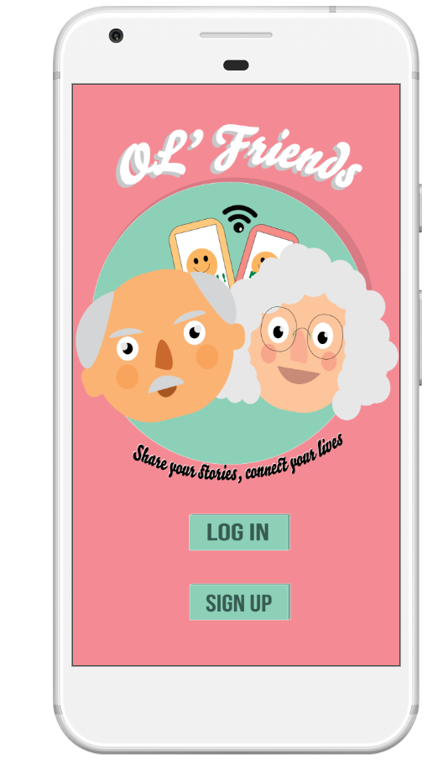
Ol’ Friends
-Share your stories, connect your lives

Slide 2
Why Ol’ Friends?

Slide 3
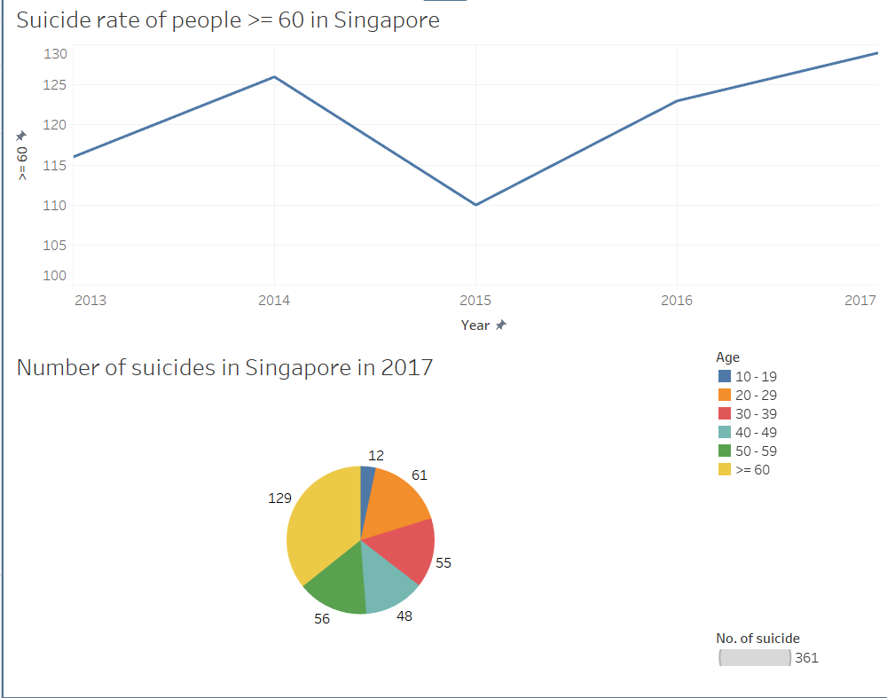
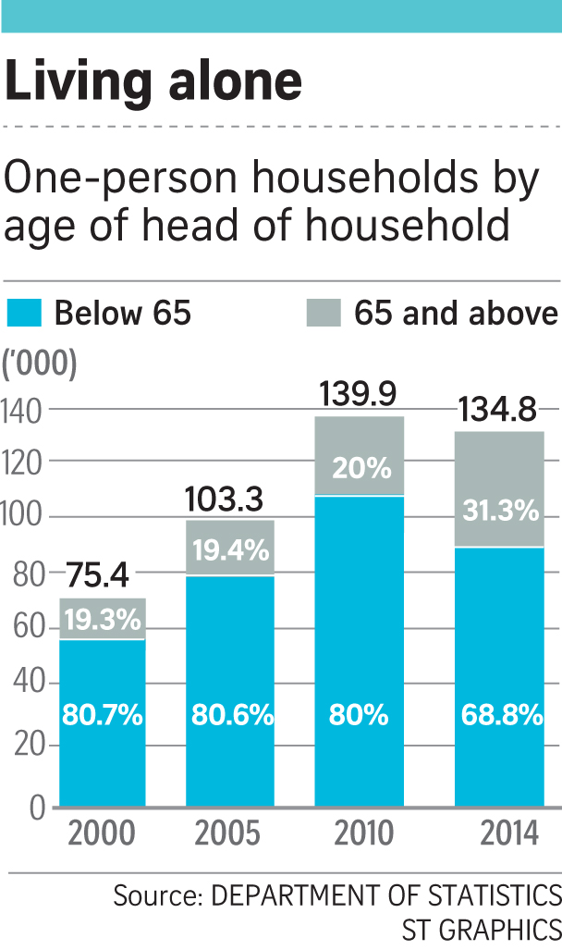
Data taken from Straits Time
Notes:
Number of suicide for people >= 60 is highest record in 2017 ever since 1991
Suicide in 2017 is 15% lower than the 429 in 2016.
The number of people taking their own lives dropped across all age groups, except for the elderly, whose number rose to the highest since suicide numbers were tracked in 1991.

Slide 4
The Elderly in Singapore are at risk of social isolation that could lead to more pressing issues like depression and inevitably suicide.

Slide 5
What Is Ol’ Friends?

Slide 6
Social media app that targets elderly in Singapore (>=65)
Simple and fuss-free interface
Key Features are:
Ol’ Friends
Matching friends based on interests.
Being able to post content on the app.
Being able to message friends on the app.
Onboarding Tutorial (in the works)
Create and attend events
Features

Slide 7
Analysis Of Ol’ Friends

Slide 8
Government Support
Strengths
Weakness
Uncharted Territory
Opportunities
Threats
Growing Market for the app
Likelihood of support from the public
Barriers to entry is relatively low. Could lead to a proliferation of copycat apps
Notes:
proposed Singapore Budget 2018 emphasis on strengthening the community care network for seniors
encourages active ageing and helps lonely seniors find new friends, will go national by 2020.
In 2014 when IDA conducted face to face interview among 3500 households, they found that for those over 60, there was an percentage increase in the number of serving the web using their smartphone. ⇒ However, just serving does not mean that they are proficient⇒ For example, in a TODAY article, A lady called Mdm Yang said she has an account but she doesn't know how to use it.

Slide 9
“No one to teach me how to use”
“Forget how to use after grandkids teach me”
“Too Complicated”
“A bit ‘Pai Seh’ to ask for help”
Notes:
Elderly are introduced to users who have similar interests.
On-boarding tutorial that can be review at anytime.
Compressed contents that can be expanded when clicked

Slide 10
Thank You
-Any Questions?

